Slide 1
Chapter 13
Database Access through the Web
Programming the World Wide Web
Fourth edition
By Robert W. Sebesta

Slide 2
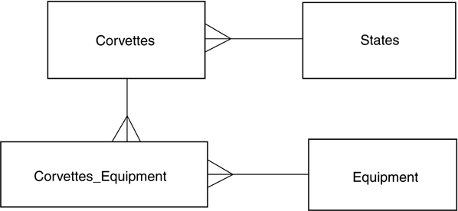
Figure 13.1 The logical data model for a database

Slide 3
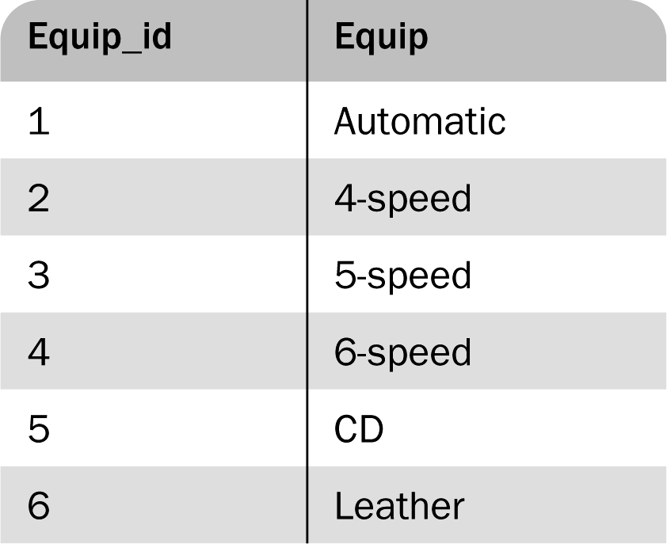
Figure 13.2 The Equipment table

Slide 4
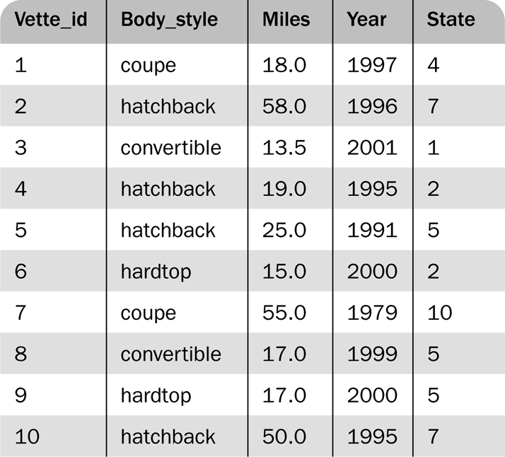
Figure 13.3 The Corvettes table

Slide 5
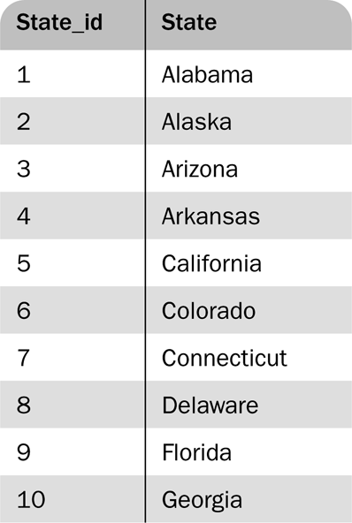
Figure 13.4 The States table

Slide 6
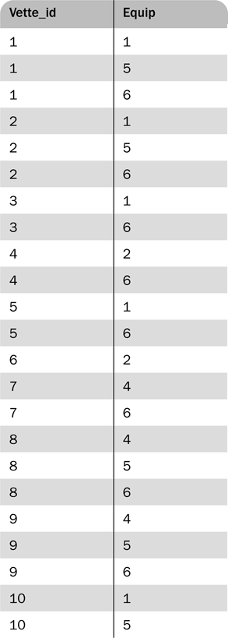
Figure 13.5 The Corvettes_Equipment cross-reference table

Slide 7
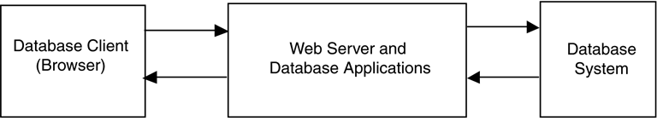
Figure 13.6 Three-tier architecture of a Web site supported by databases

Slide 8
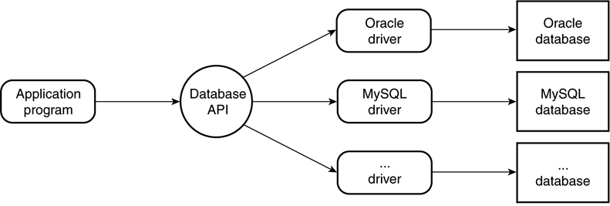
Figure 13.7 Common database access architecture

Slide 9
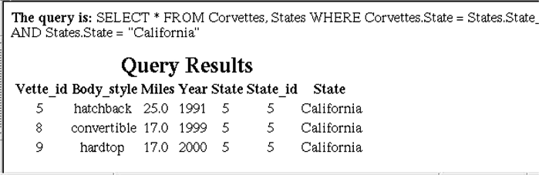
Figure 13.8 Display of the output of access_cars.pl

Slide 10
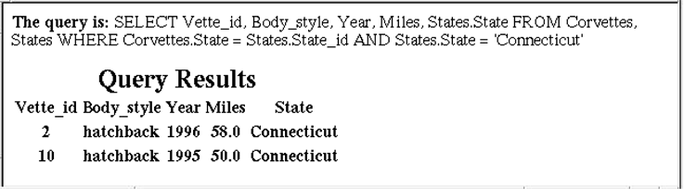
Figure 13.9 Display of the return document from access_cars.php

Slide 11
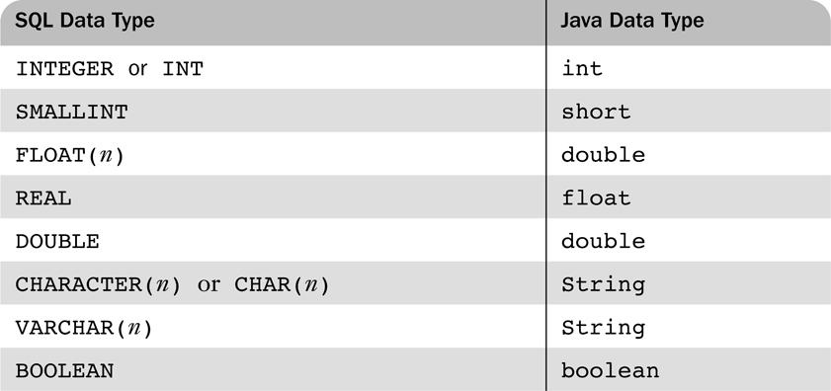
Table 13.1 Common SQL data types and their Java counterparts

Slide 12
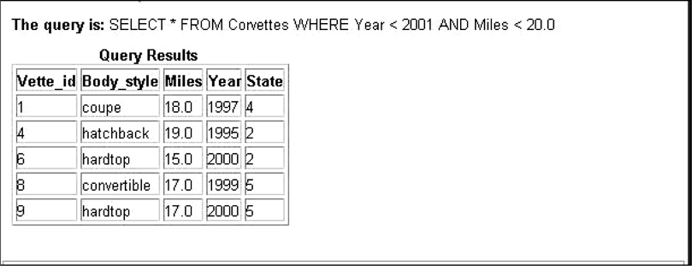
Figure 13.10 Display of the results of JDBCServlet

